Slide 1

Innovative Design and Optimization of Arithmetic Circuits in Quantum Computing
Siyi Wang siyi002@e.ntu.edu.sg College of Computing and Data Science

Slide 2
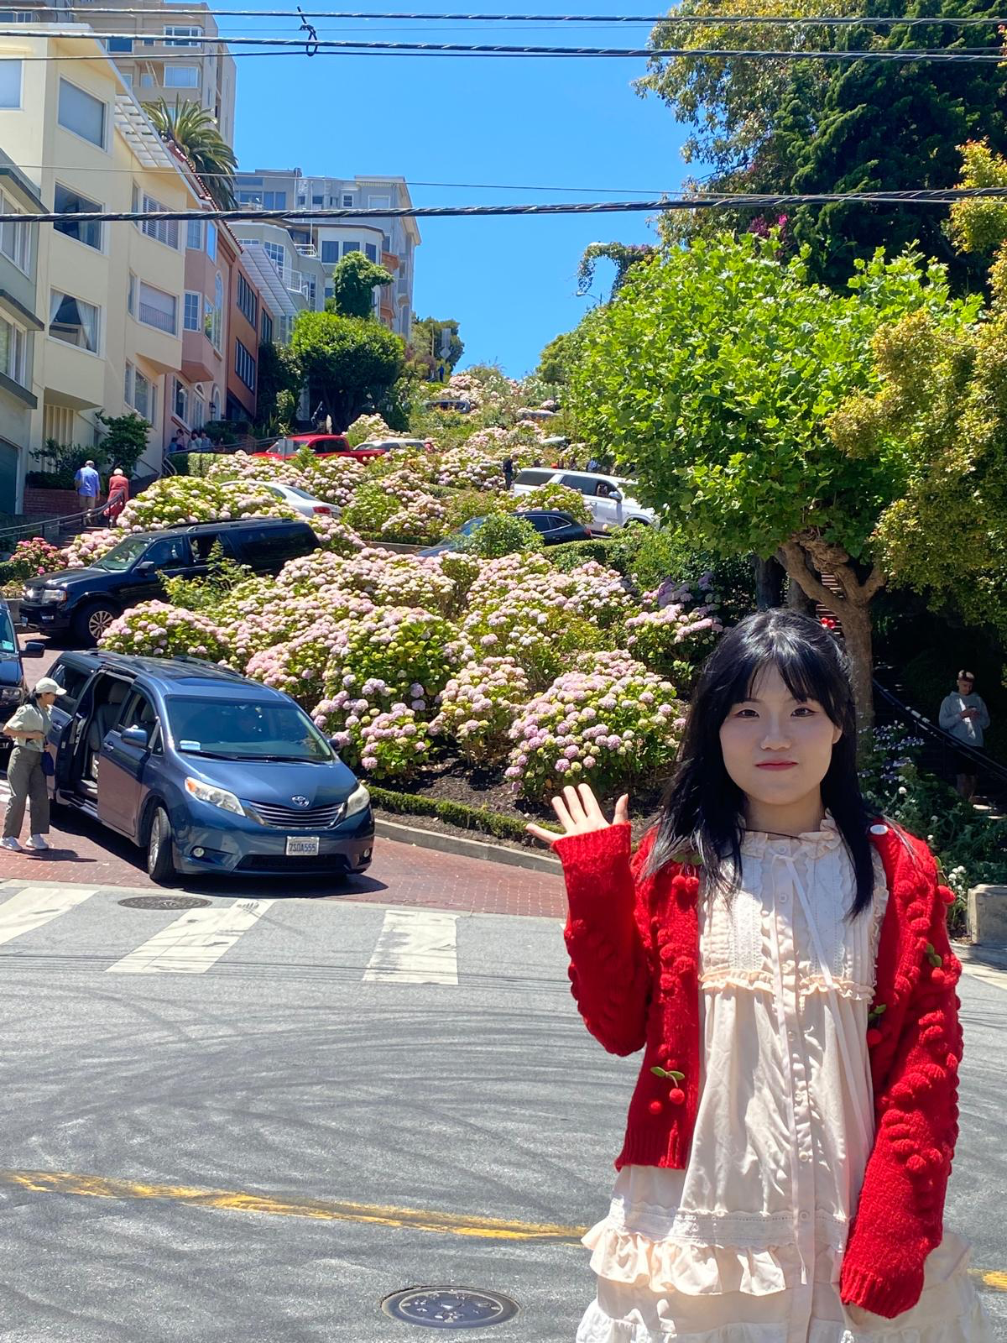
Siyi Wang
PhD Candidate, CCDS
Research Focus
Quantum Computing
Quantum Cryptography

Slide 3
Content
01
02
Background
Preliminaries
03
04
Arithmetic Designs
Hardware Validation
05
06
Applications
Conclusion

Slide 4
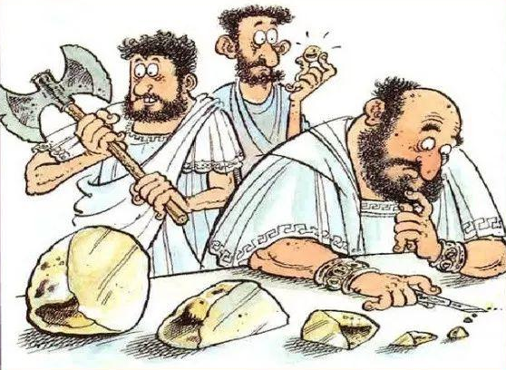
01
Background
The beginning of this story......
From ancient Greece,
people were already curious about Atoms.
Ancient Greece

Slide 5
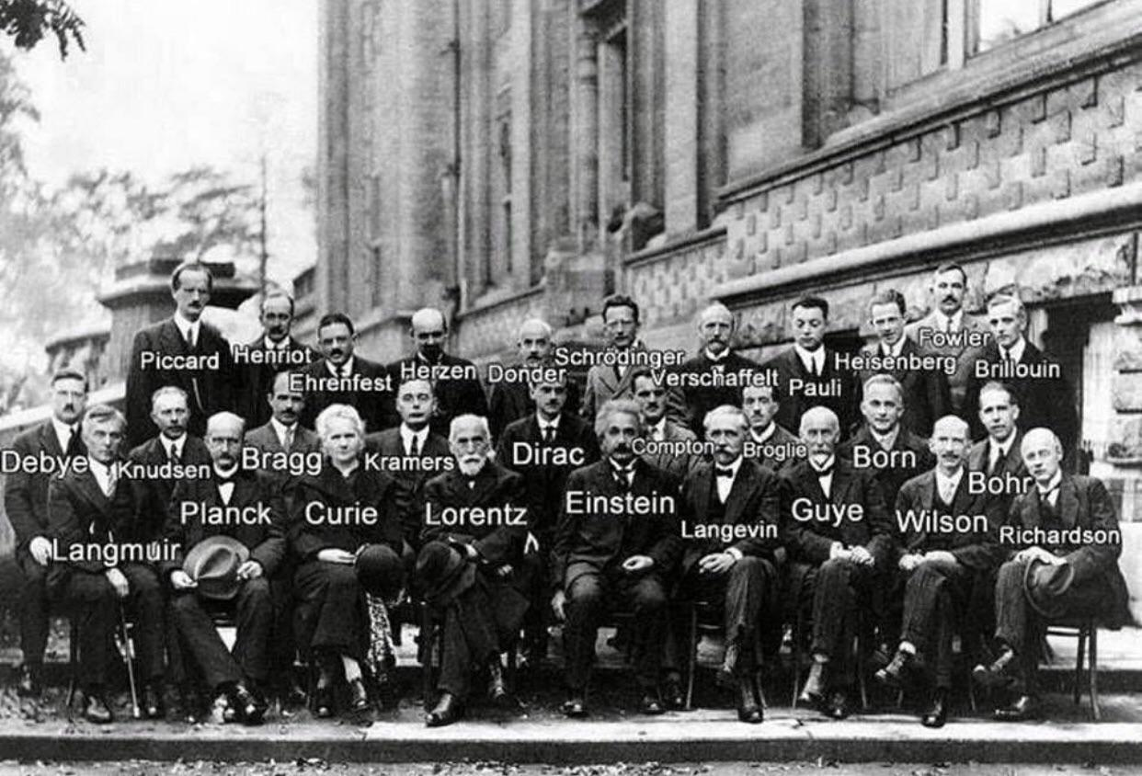
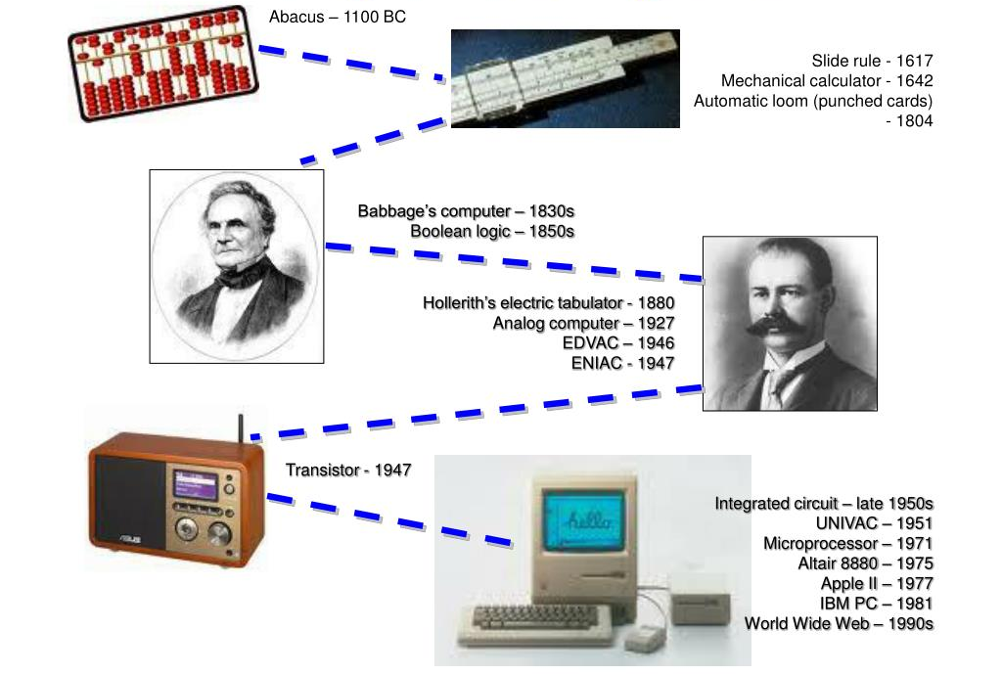
Quantum Mechanics and Computing
5th Solvay Conference on Quantum Mechanics, 1927.
History of Computing.
Quantum Mechanics
Computing
Quantum Computing

Slide 6
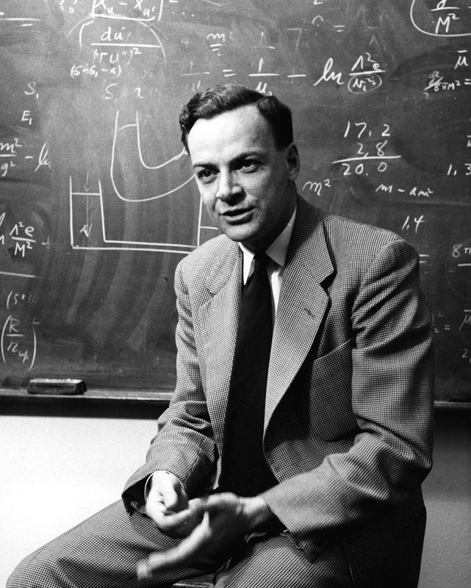
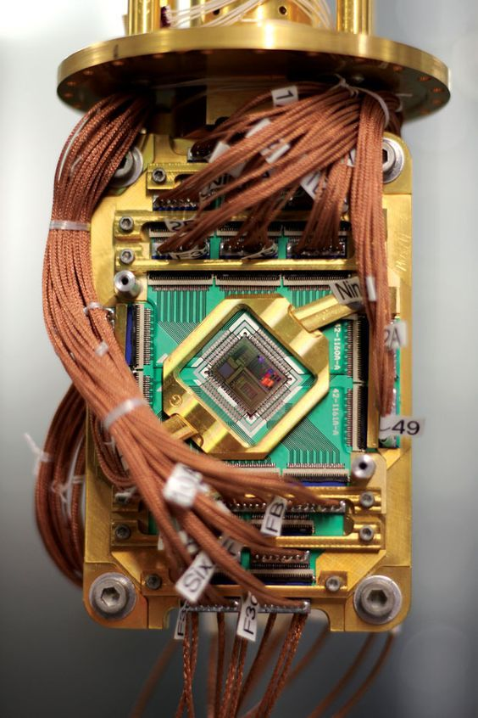
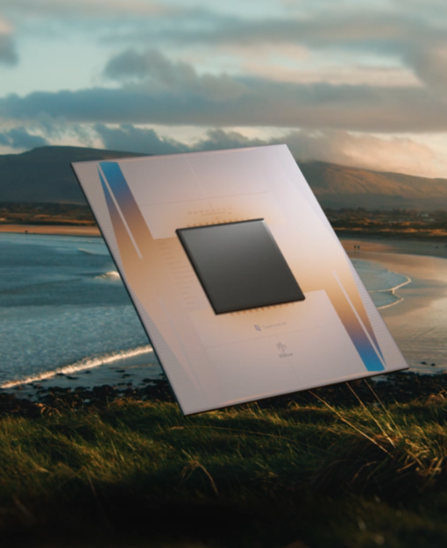
The development of quantum Computing
1981
Richard Feynman proposed quantum computing in his talk.
2011
First commercial Computer
D-Wave One.
2024
Google's Willow Quantum Chip.

Slide 7
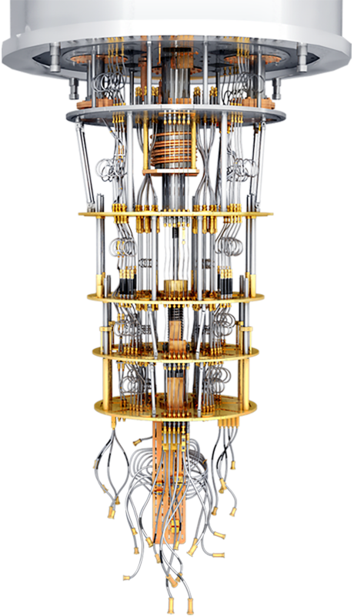



Quantum Computing
Quantum Computer
Quantum computers promise breakthroughs across domains by offering speedups over classical algorithms. A landmark example is Shor’s algorithm^{[1]}, which threatens public-key cryptographic systems such as RSA and ECC.
Quantum arithmetic serves as a basic building block in many quantum algorithms. In particular, the efficiency of Shor’s algorithm^{[1]} relies heavily on arithmetic blocks.
Finance
Drug Discovery
Cryptography

Slide 8

Research Gap
Some work has already been conducted on quantum arithmetic.
However...
Narrow focus: Existing work primarily optimizes arithmetic circuits for specific problems only.
Unexplored areas: Important topics like modular arithmetic and division remain under-investigated.
Absence of general framework: No general, systematic methodology exists for designing quantum arithmetic blocks.
Missing comprehensive survey: An up-to-date, thorough review of this field is still lacking.

Slide 9


Research Question
How to improve the efficiency of Quantum Arithmetic?

Slide 10
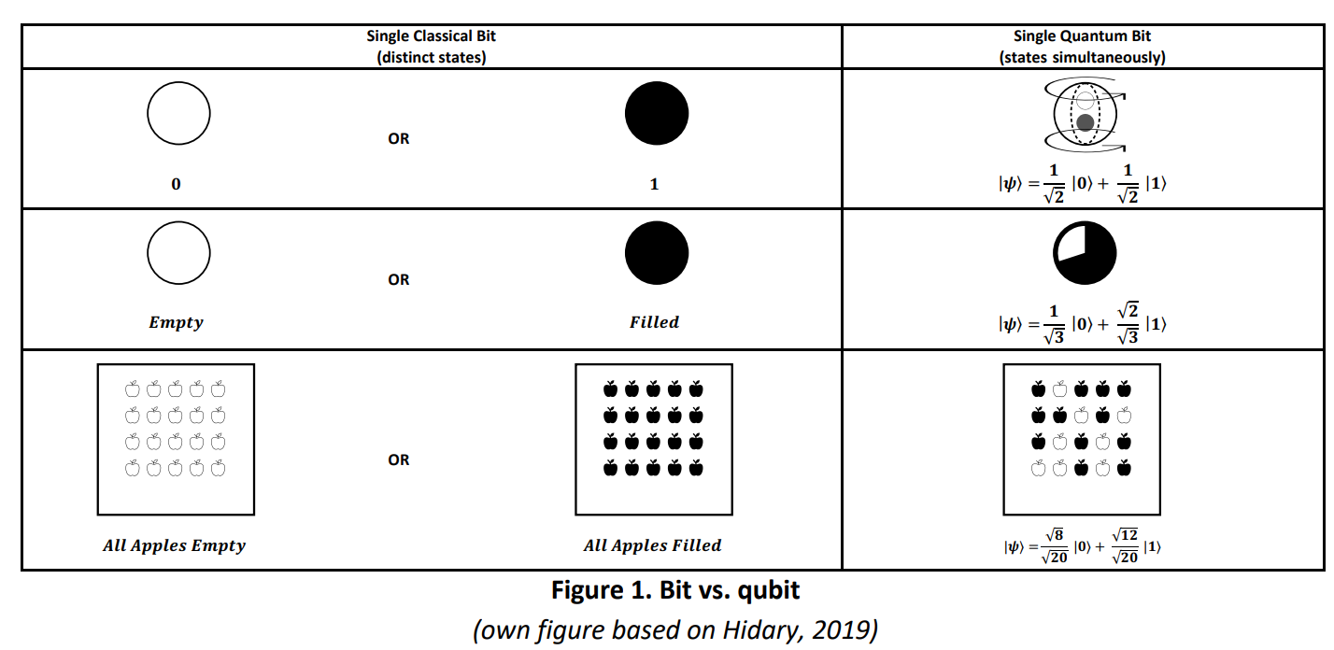
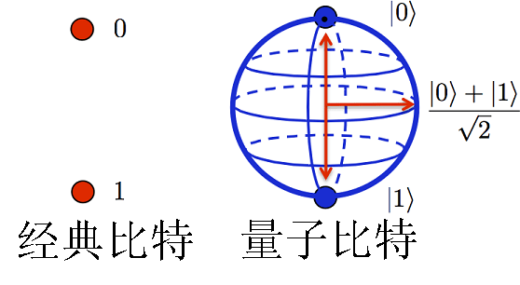
02
Preliminaries
Bit vs. Qubit
Classical Bit
Distinct States
Quantum Bit (Qubit)
States Simultaneously
All Apples Filled
OR
All Apples Empty
Expensive!

Slide 11
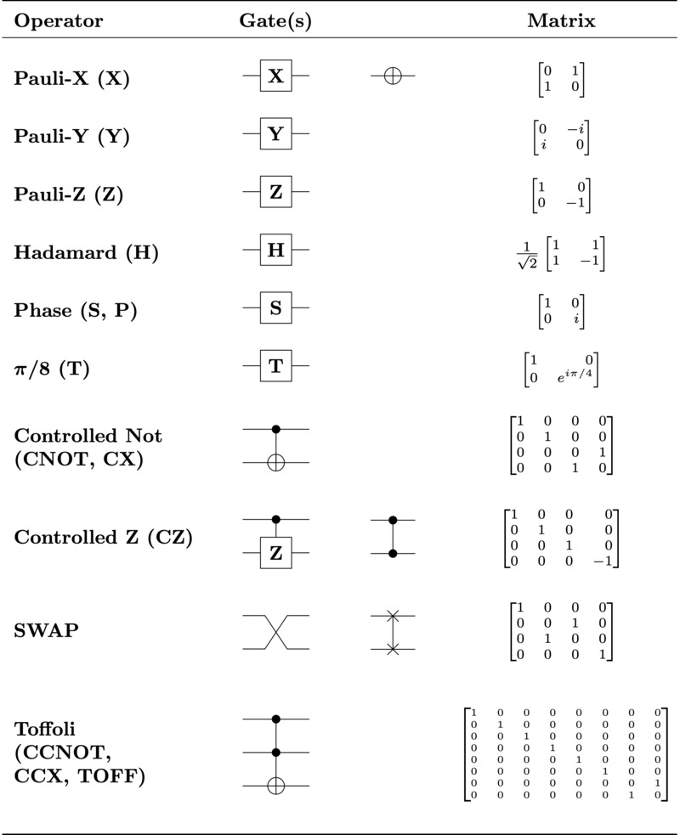
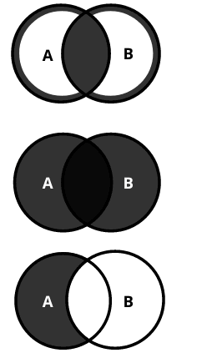
Quantum Gates
Here is a concise overview of basic quantum logic gates, including corresponding quantum circuits as well as unitary matrices.
Quantum Logical Gates
Classical Logical Gates
AND
OR
NOT
Expensive!

Slide 12
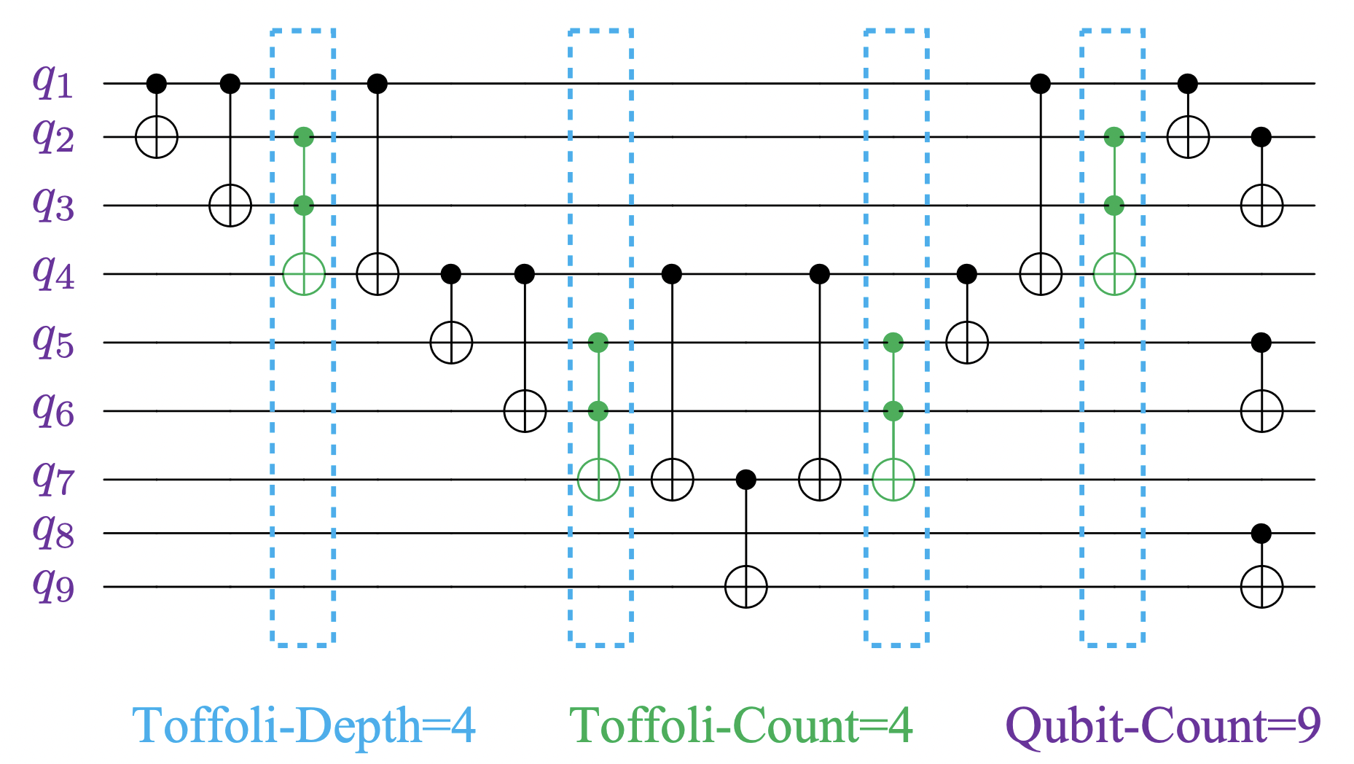
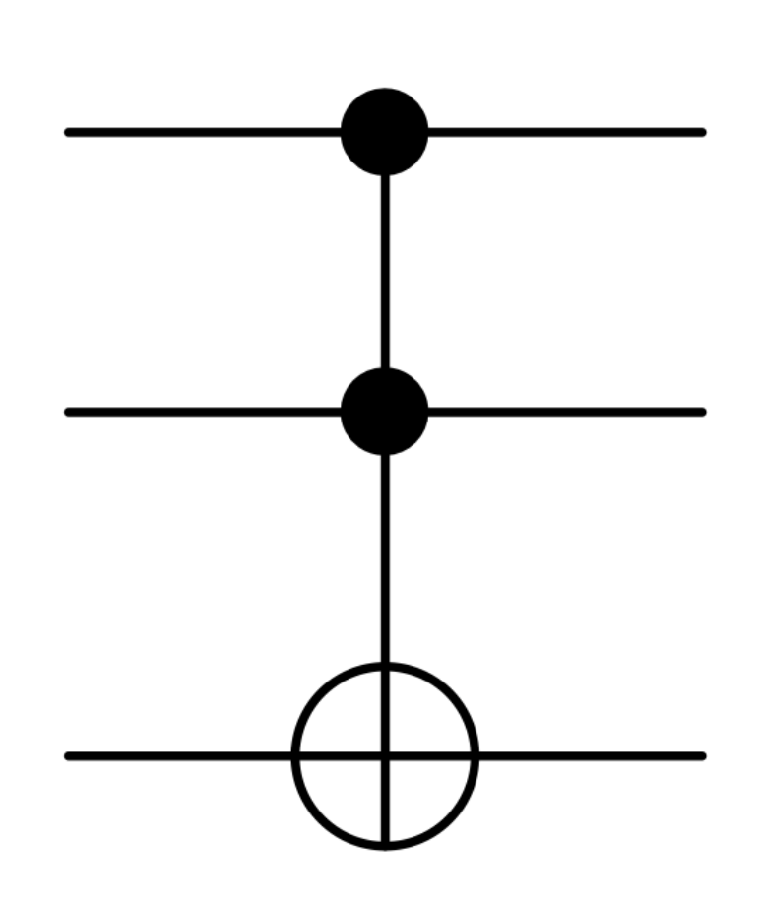
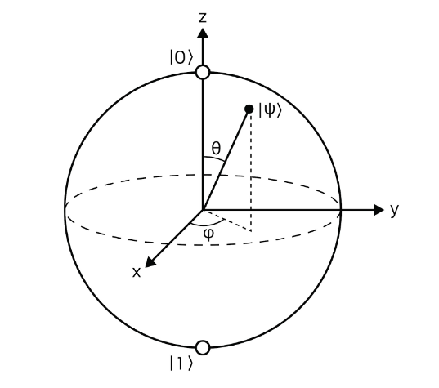
Evaluation Metrics
Most Expensive Quantum Resources
Toffoli Gate
Qubit
Toffoli-Depth (TD)
Toffoli-Count (TC)
Qubit-Count (QC)
Main
Metrics

Slide 13
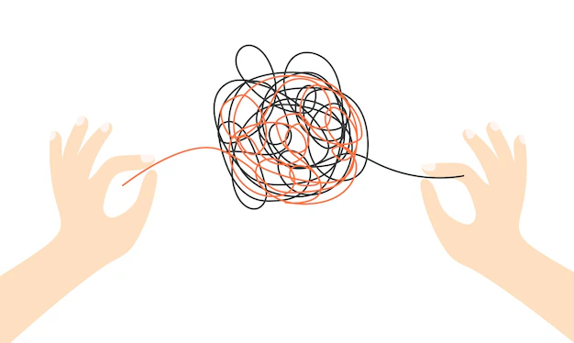
03
Arithmetic Designs
There are several strong works exist, but...
Previous
Designs
MOD

Slide 14
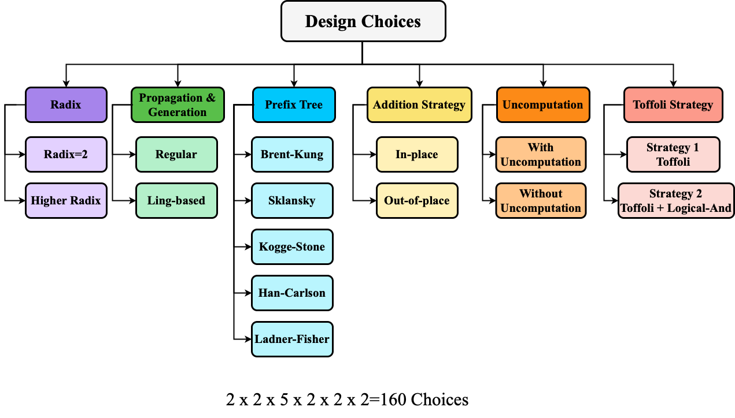
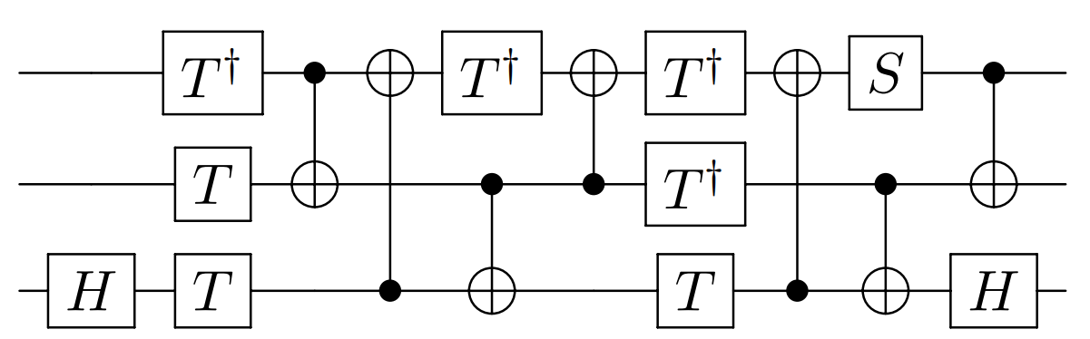
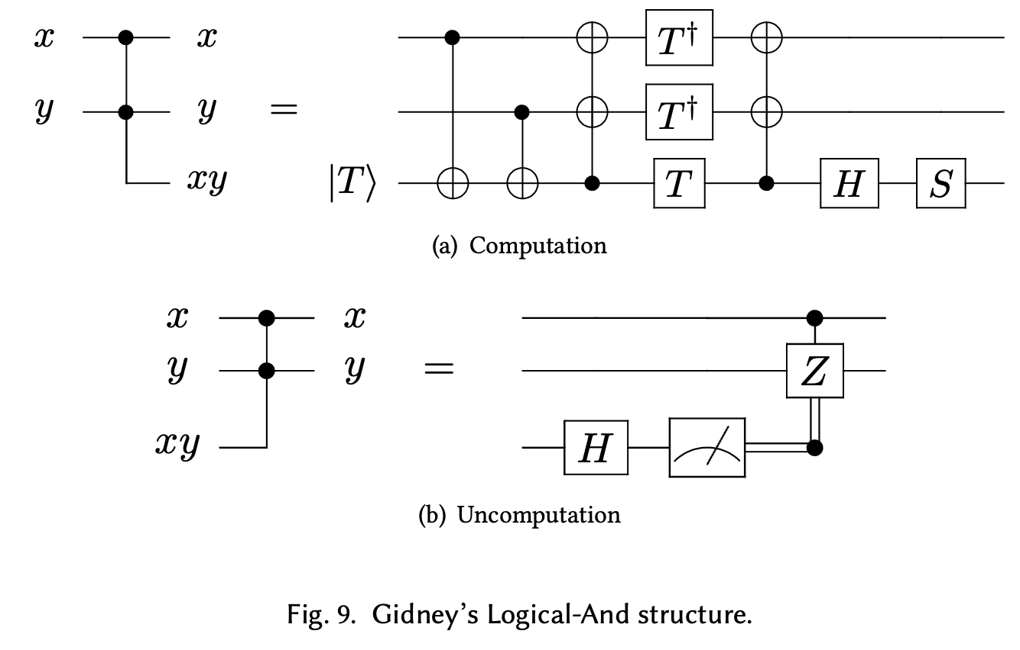
Addition
✓
✓
✓
↓ Qubit-Count
↓ Toffoli-Count (7*2→ 4)
↓ Toffoli-Depth (3*2→ 2)
Our Exploration!
Strategy 1
Computation
→
Computation^{[2]}
Strategy 2
Uncomputation
Uncomputation^{[2]}

Slide 15
Design Choice 1: Radix
Quantum Higher Radix Adder
✓
✓
✓
✓
✓

Slide 16
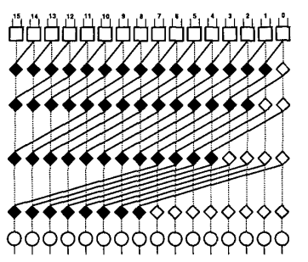
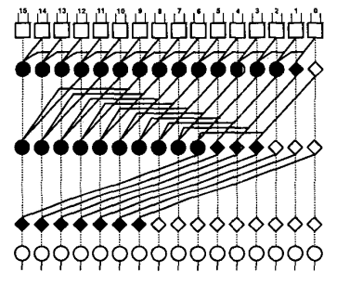
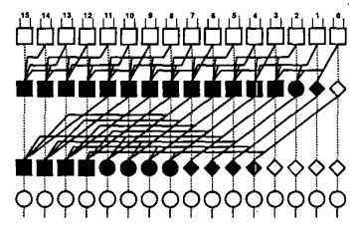
What is Radix？
Using the higher radix to reduce T-depth and overall time cost.
4
3
2
Radix 2
(Default)
Radix 3
Radix 4

Slide 17
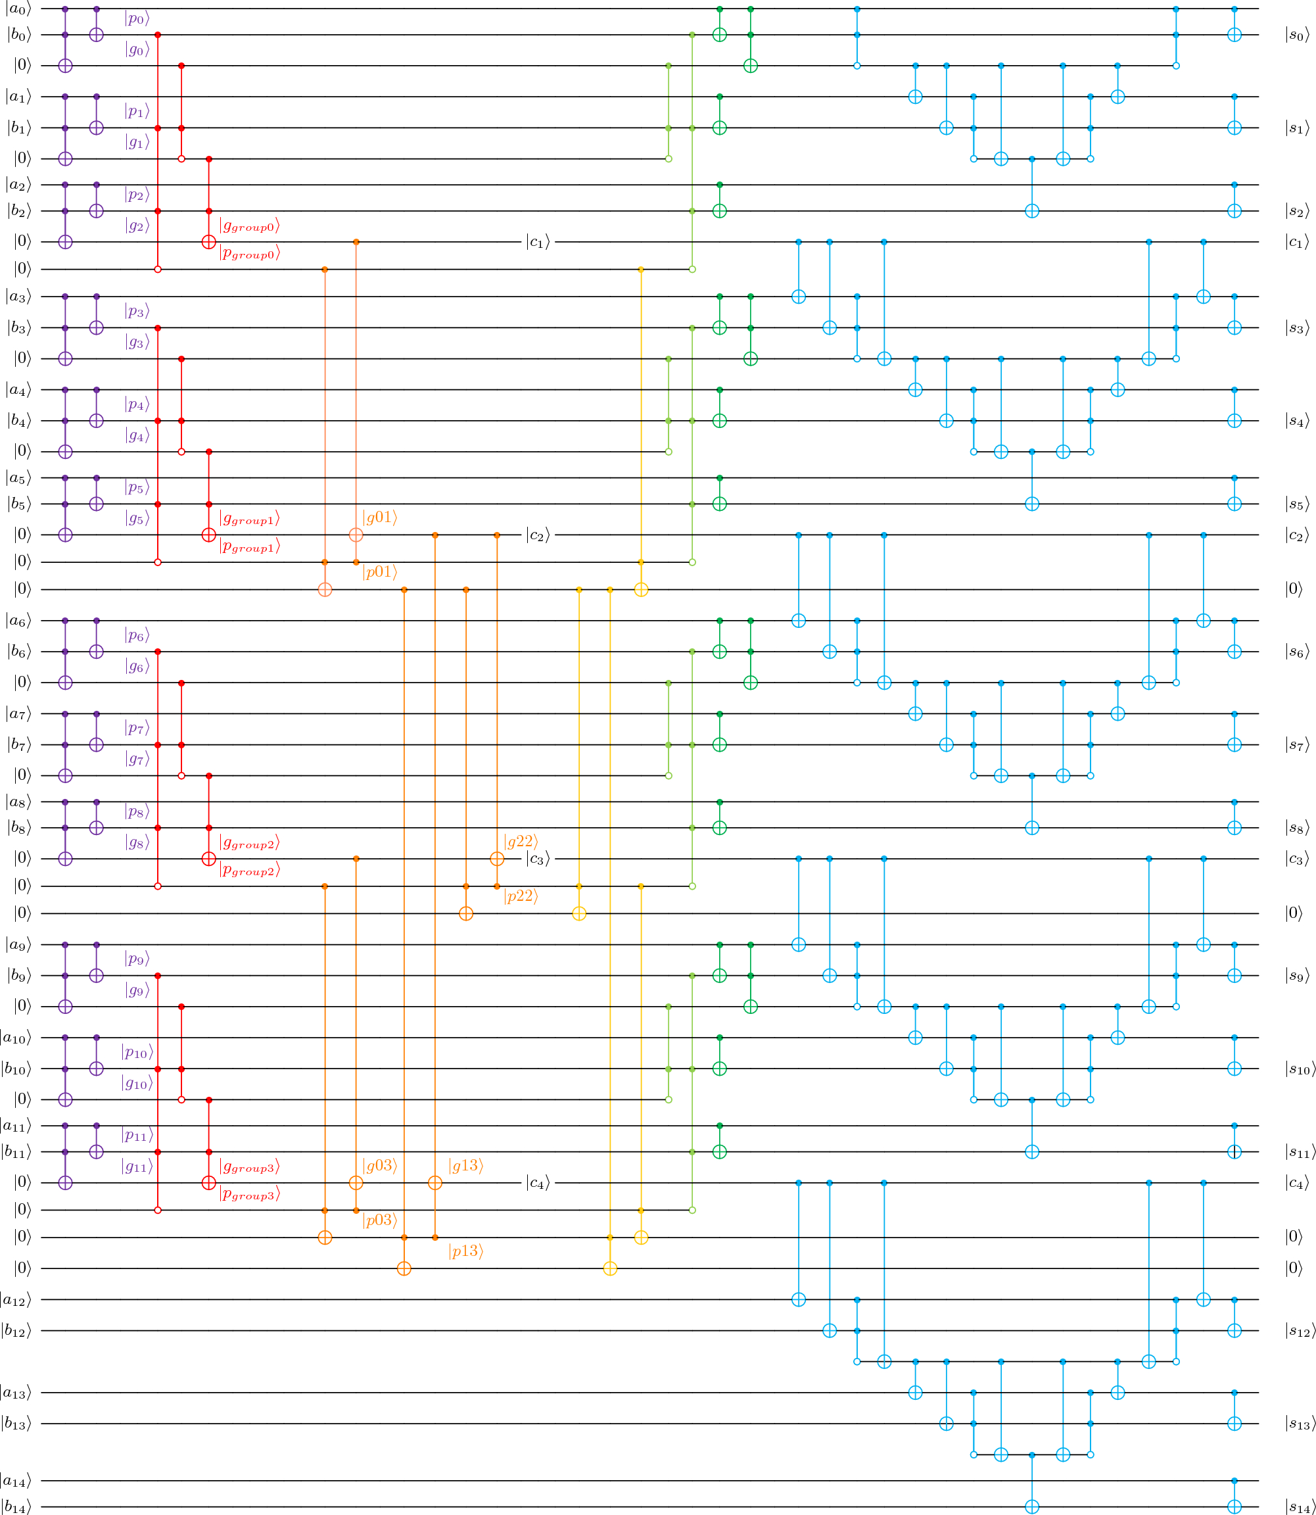
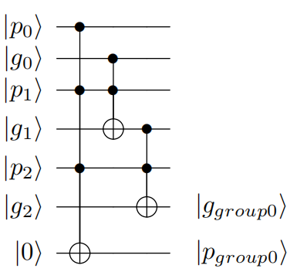
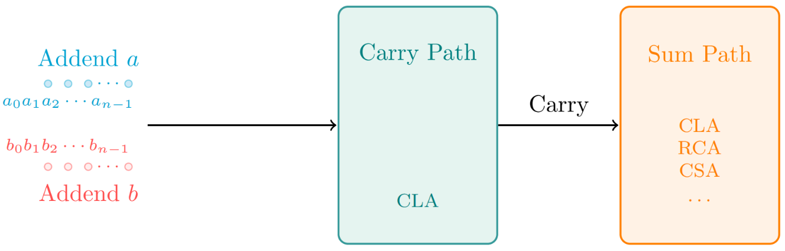
Our Design
Example
Radix=3
Addition Size=15
Initialization
Radix 3
Higher Radix Structure
Higher
Radix
Structure
Carry Path
General Framework
Sum Path

Slide 18
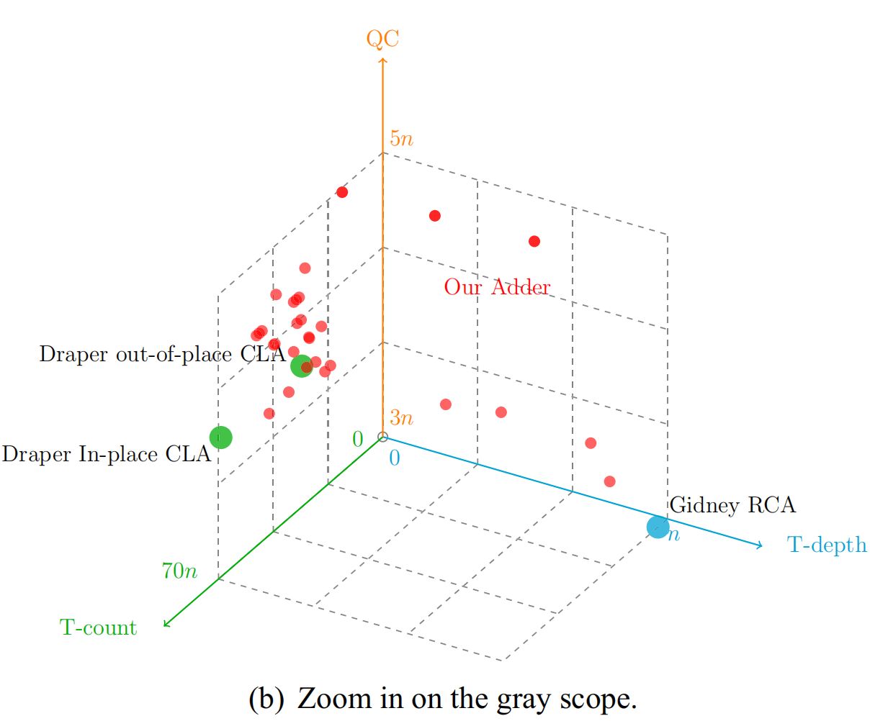
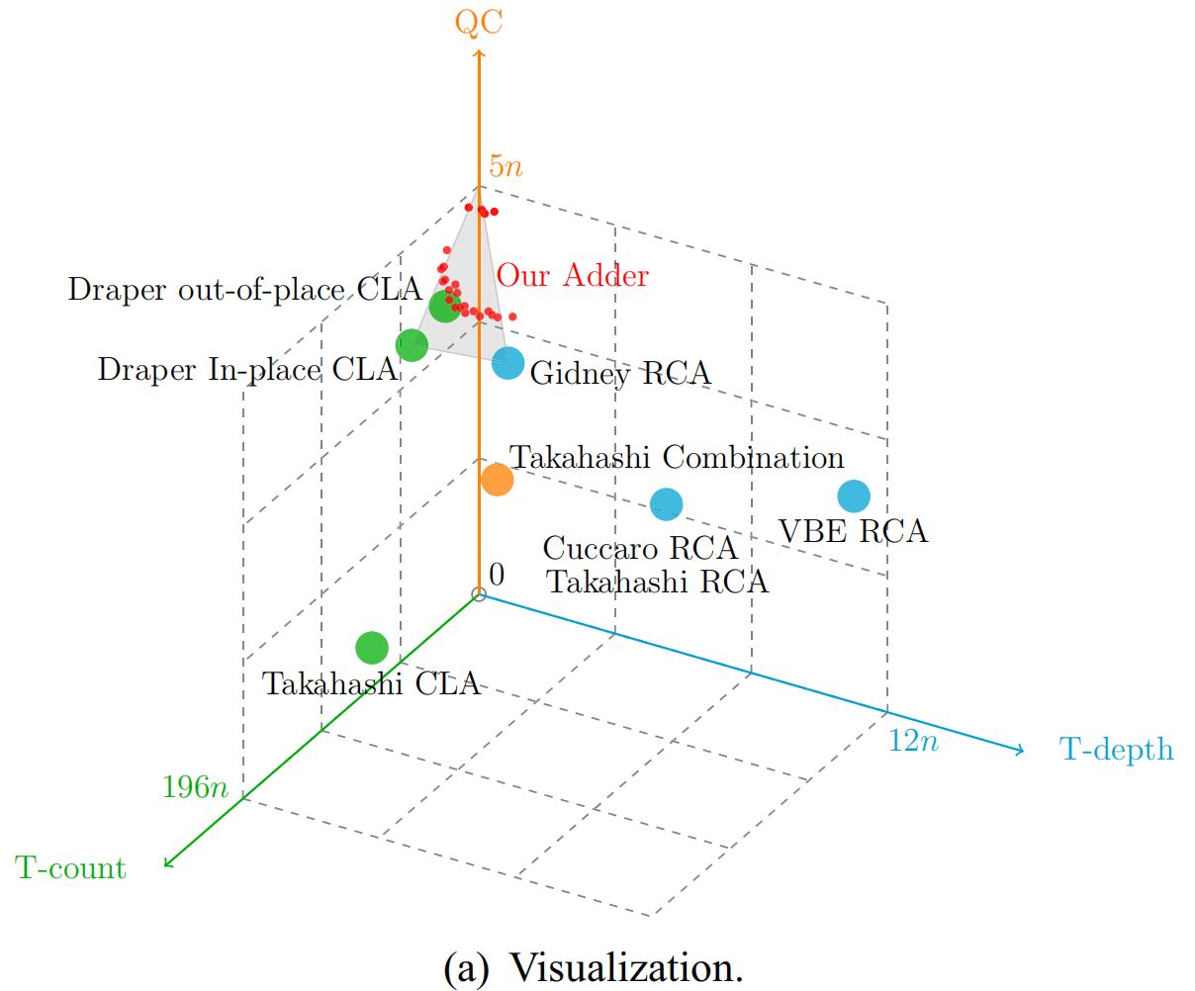
Performance of Our Design
Our work can be seen as a bridge to connect existing quantum adders.
QC
QC
TD
TD
TC
TC
Zoom in on the gray scope

Slide 19
Design Choice 2: Propagation & Generation Method
✓
✓
✓
✓
✓

Slide 20
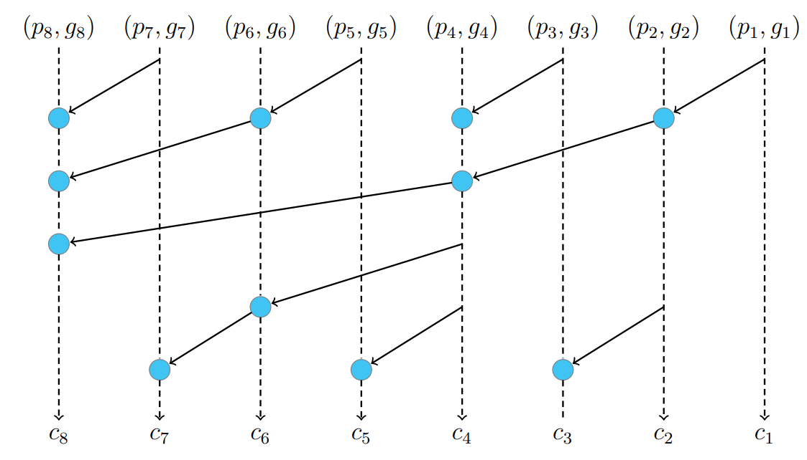
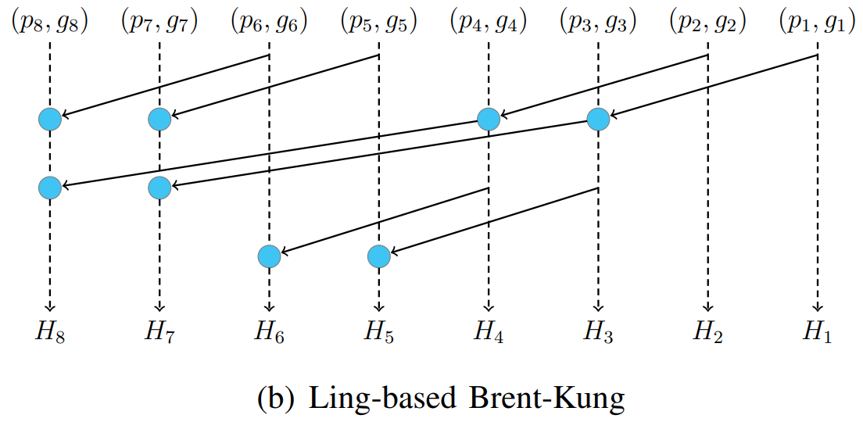
What is Ling-based Propagation & Generation Method？
Ling structure can reduce T-depth sharply.
O(2log₂n)
O(2log₂(n/2))
5
3
General Method
Ling-based Method

Slide 21
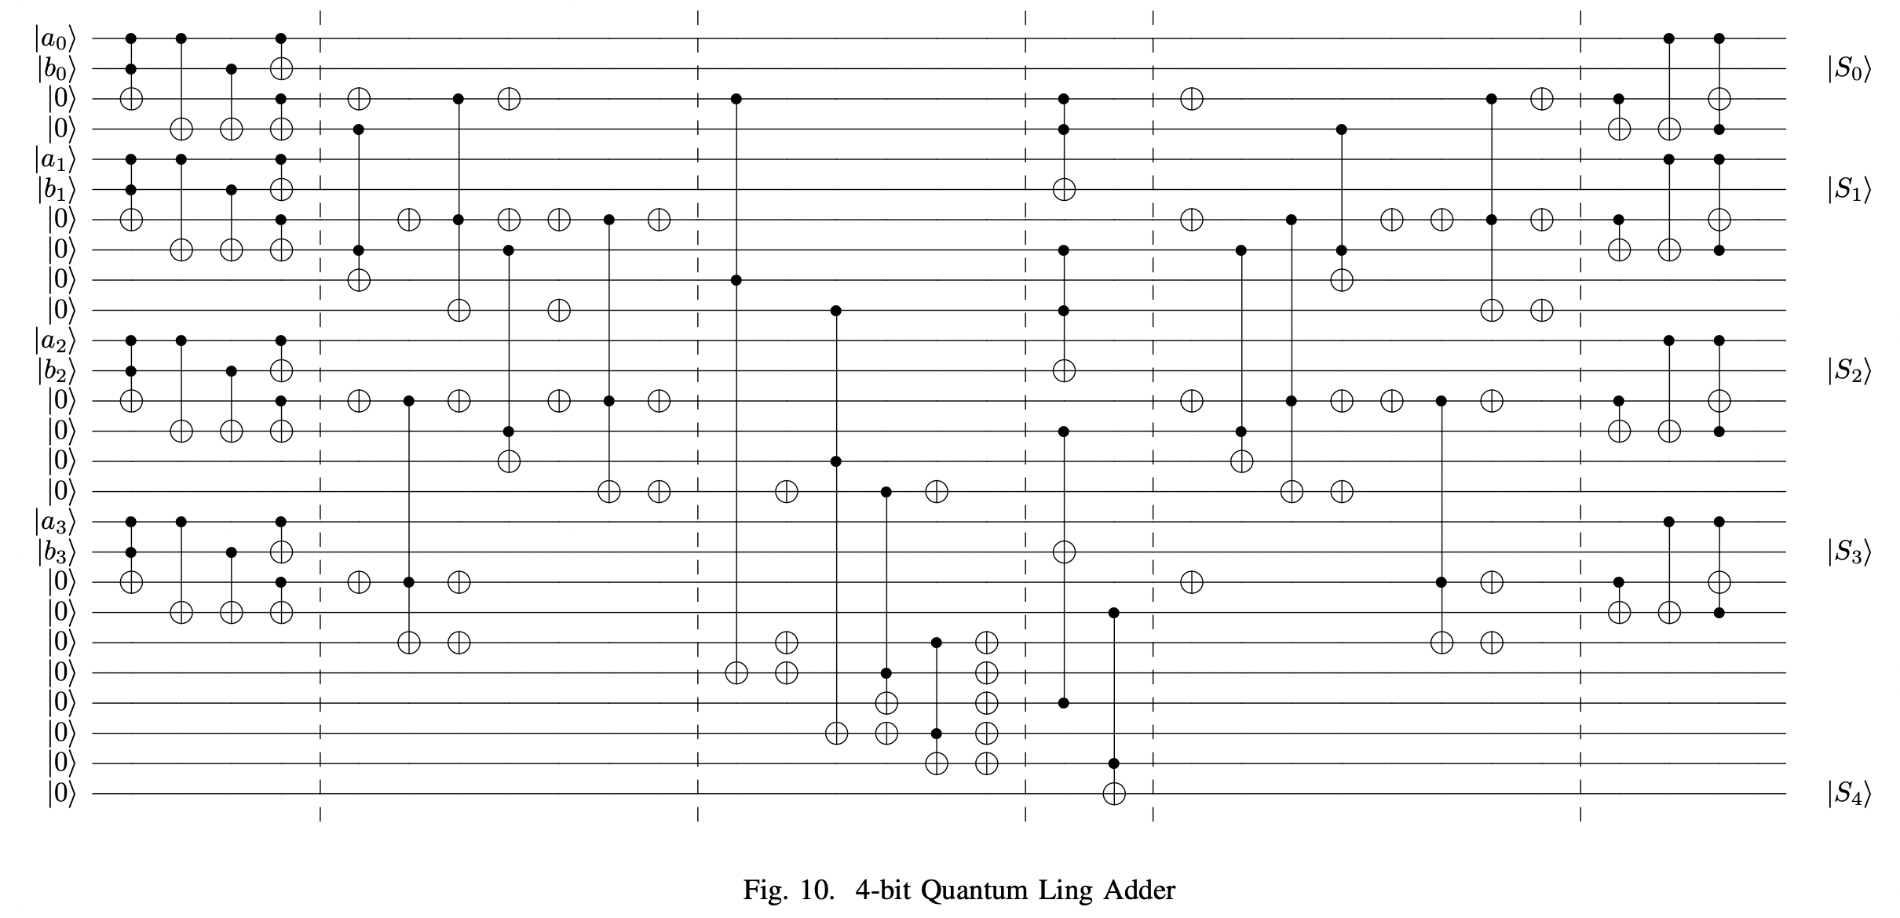
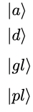
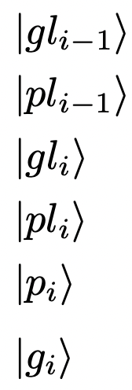
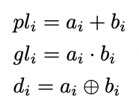
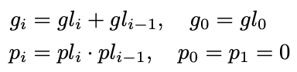
Our Design (Example: Addition Size=4)
Ling Initialization
Ling Pre-calculation
Ling Propagation & Generation
Sum
Uncompute Propagation & Generation
Uncompute Initialization
Similar to Carry Path
Similar to Sum Path

Slide 22
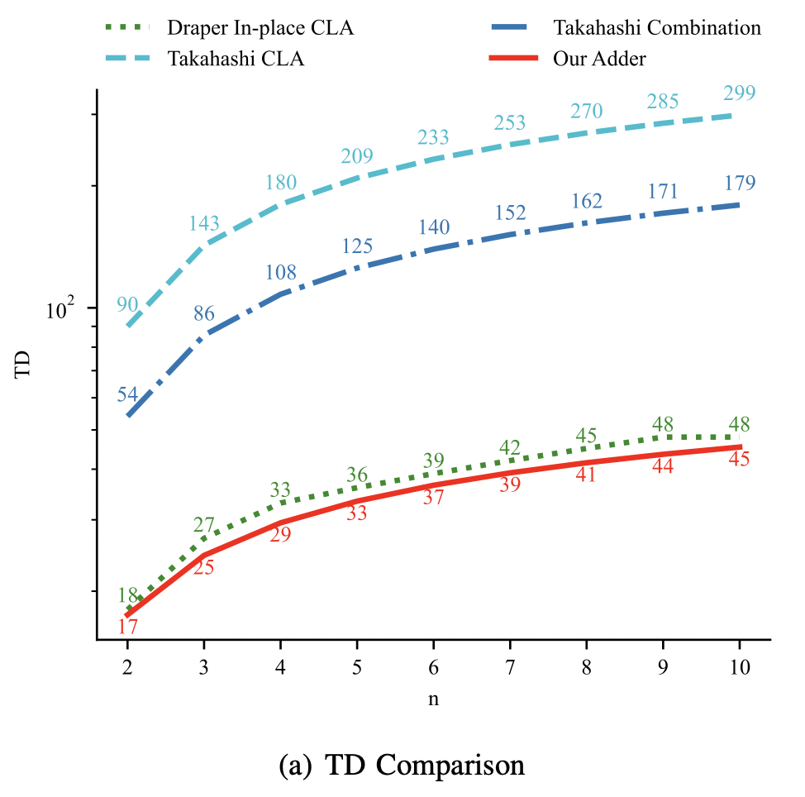
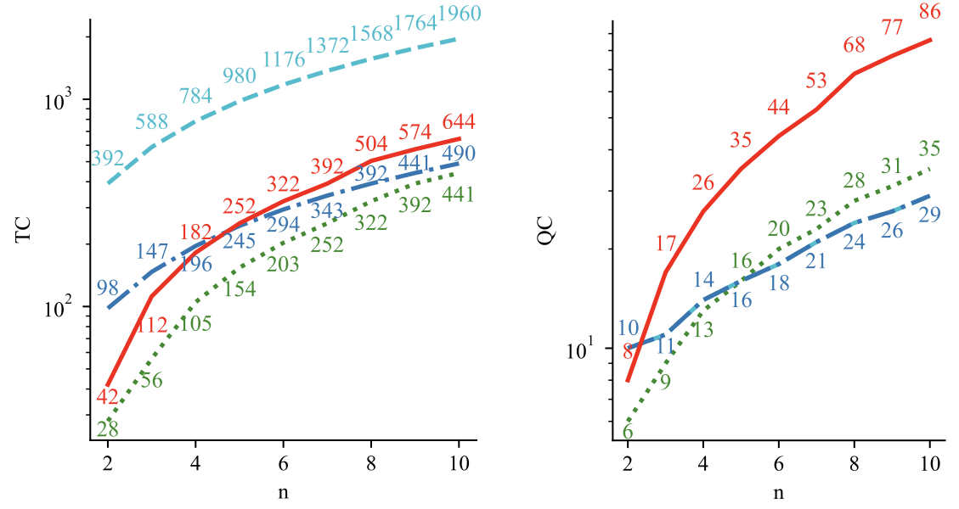
Performance of Our Design
[3]
[5]
[4]
TC Comparison
QC Comparison
Our design achieves a reduced TD of O(log (n/2)), improving over other Q adders with O(log n) TD.
TD Comparison

Slide 23
Design Choice 3: Prefix Tree
✓
✓
✓
✓
✓
✓

Slide 24
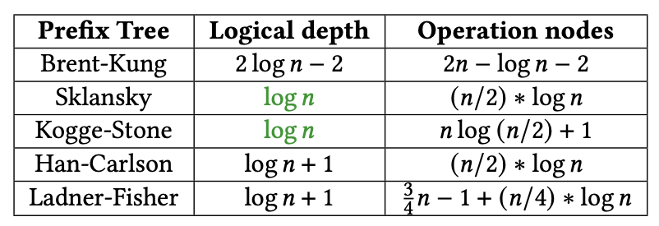
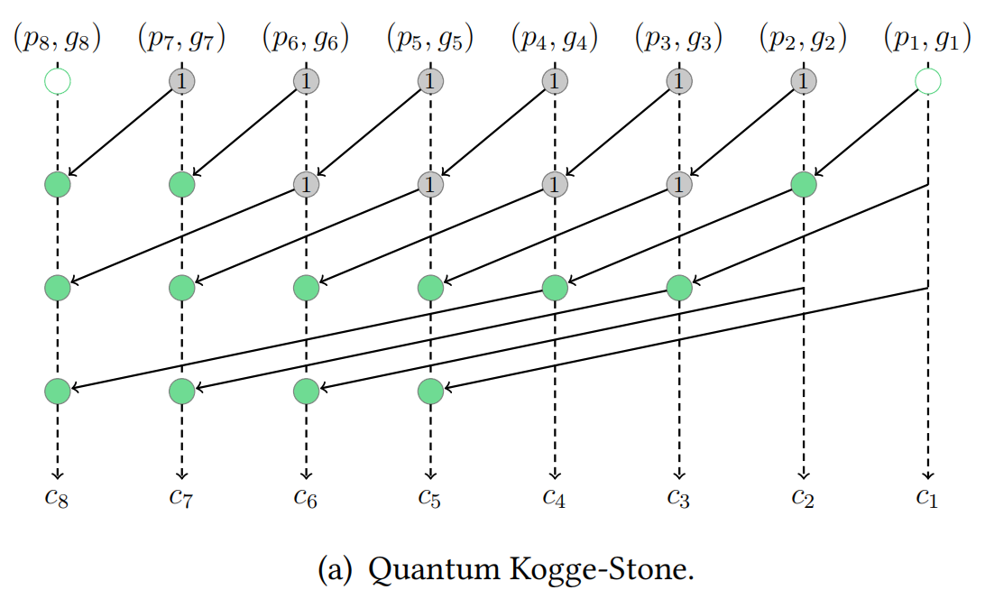
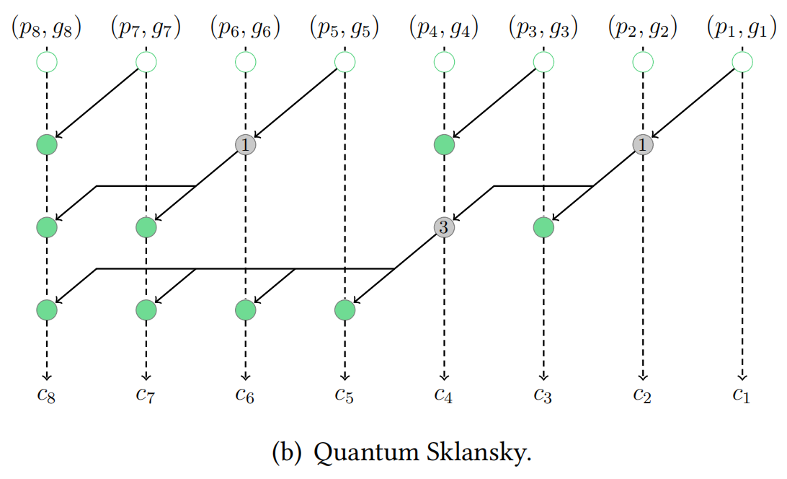
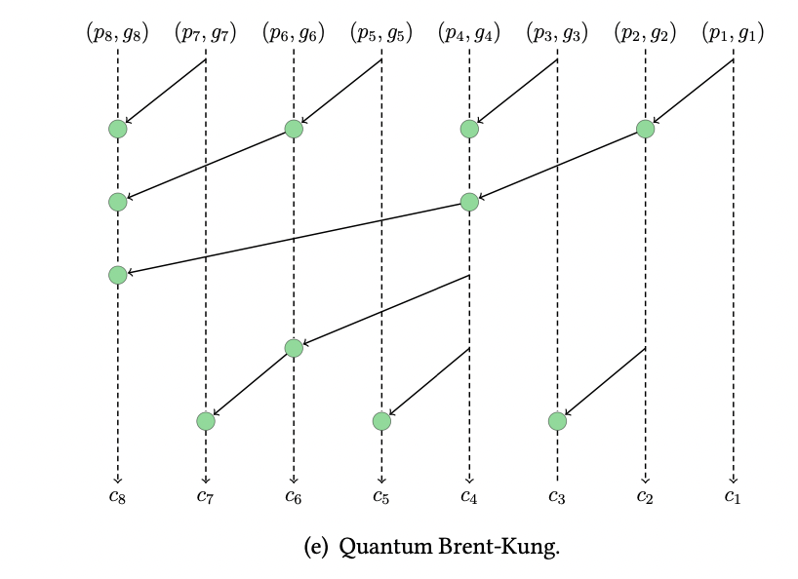
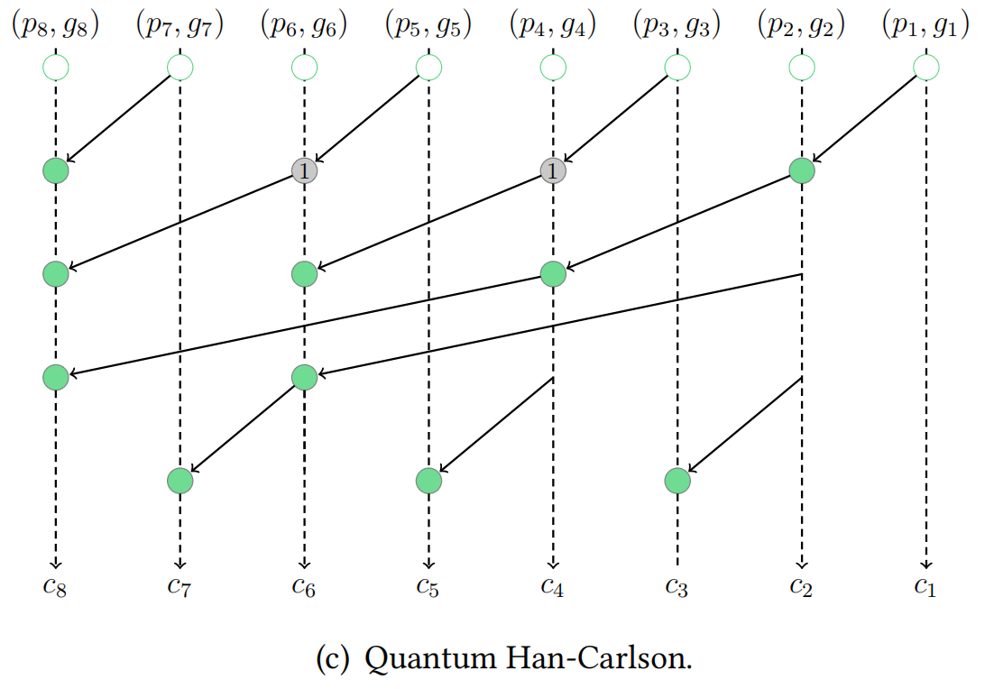
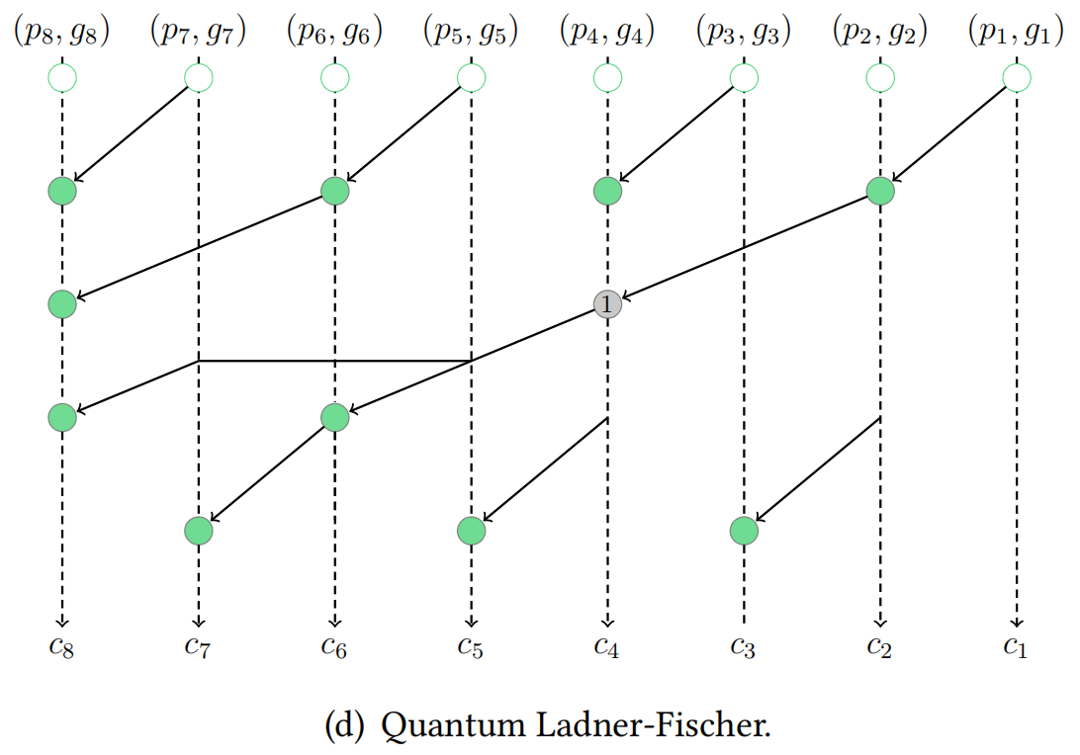

What is Prefix Tree?
A tree structure that efficiently computes carry signals by combining intermediate results in parallel.
Choice of Classical Prefix Tree
Quantum Kogge-Stone
Quantum Sklansky
✓
Are we the perfect match?
Quantum
Add
Brent-Kung
Quantum Brent-Kung (Default)
Quantum Han-Carlson
Quantum Ladner-Fischer

Slide 25
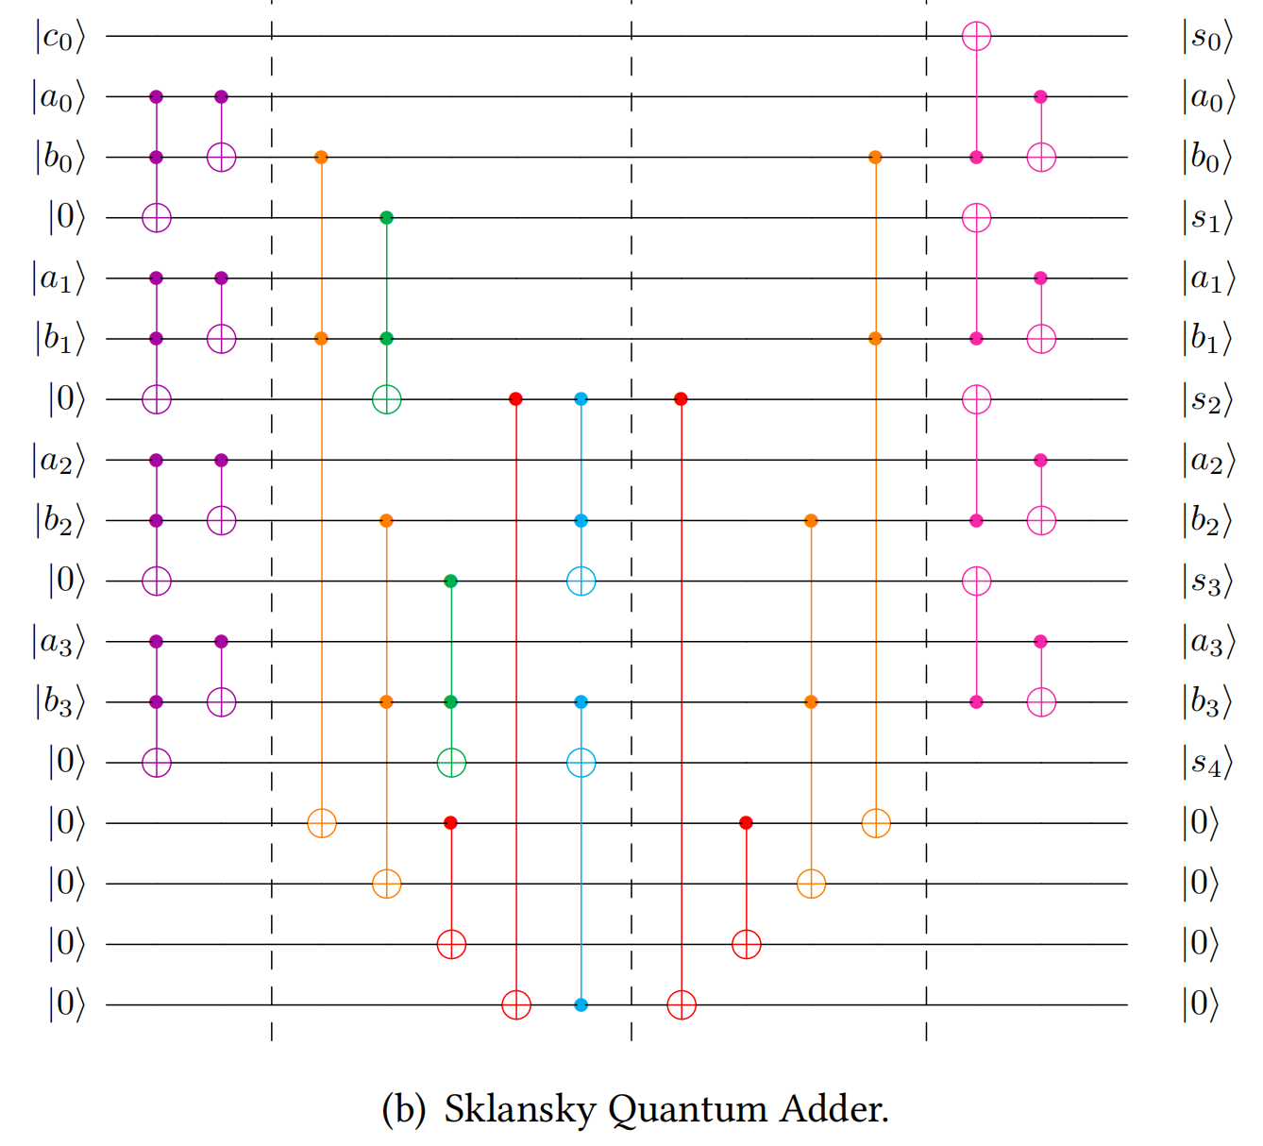
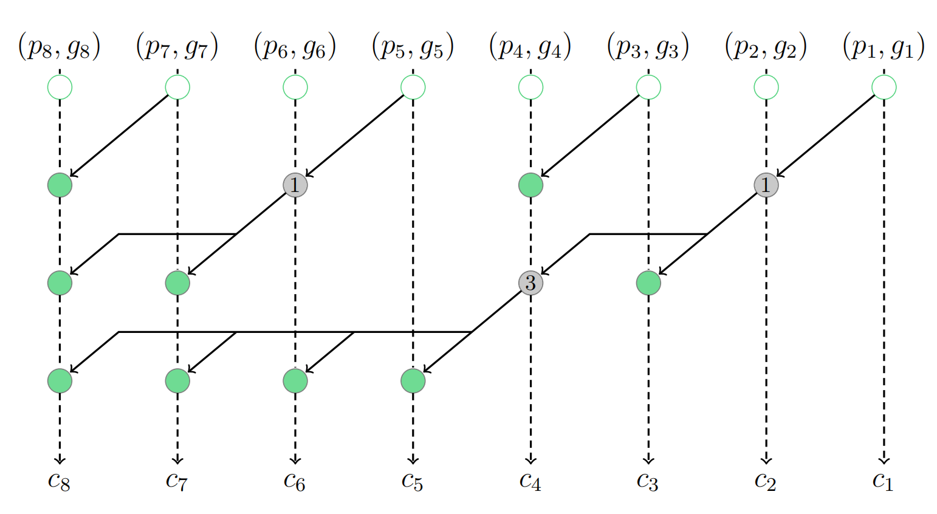
Our Design
Optimal Depth Add= Sklansky Tree + In-place + With Uncomputation+ Toffoli Strategy 2
Initialization
Carry Path
(Sklansky)
Uncomputation
Sum Path
Sklansky Tree
Pre-calculation
Carry Propagation & Generation
CNOT operations, with numbers in circles indicating the number of CNOT operations.

Slide 26
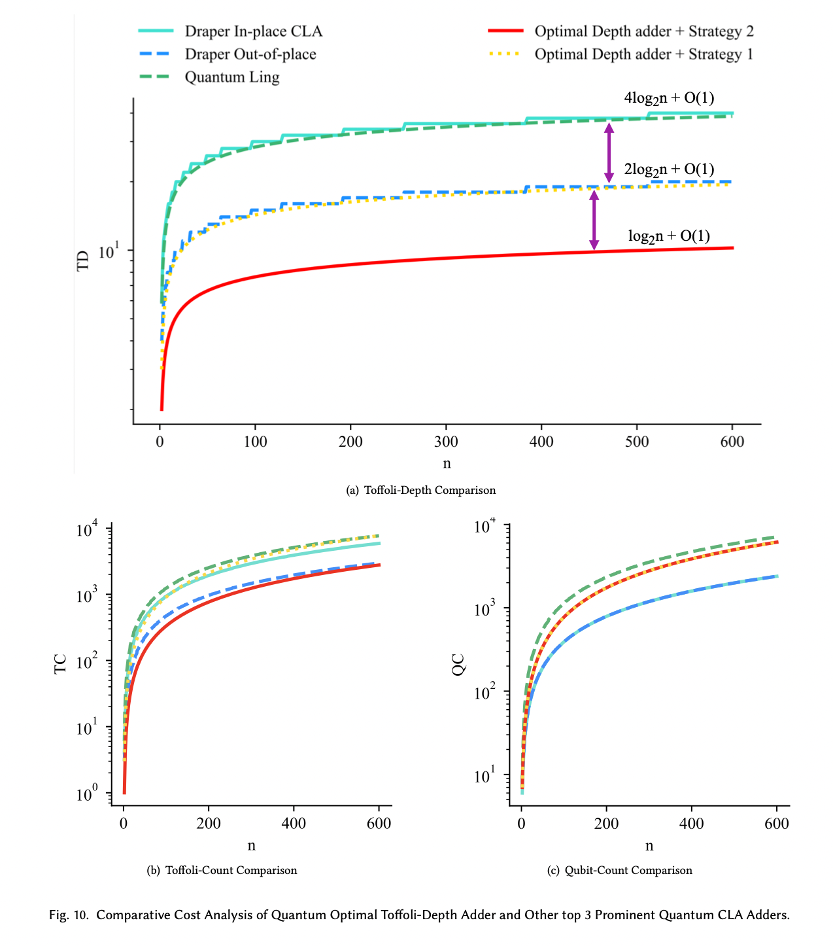
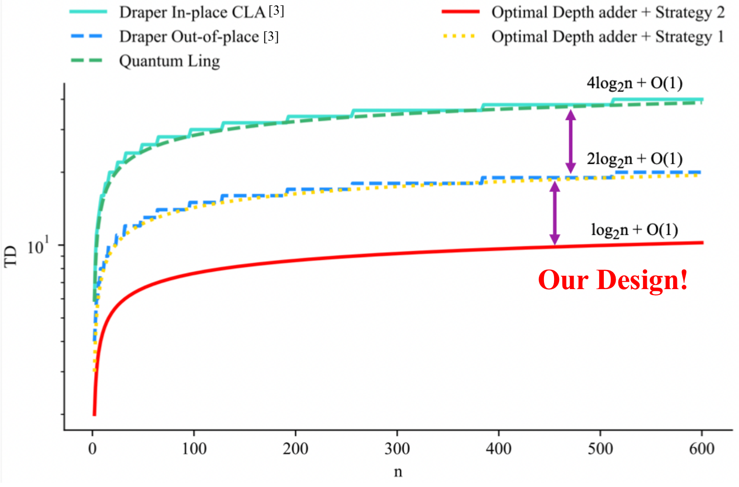
Performance of Our Design
TC Comparison
QC Comparison
TD Comparison

Slide 27
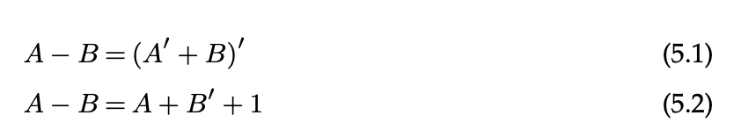
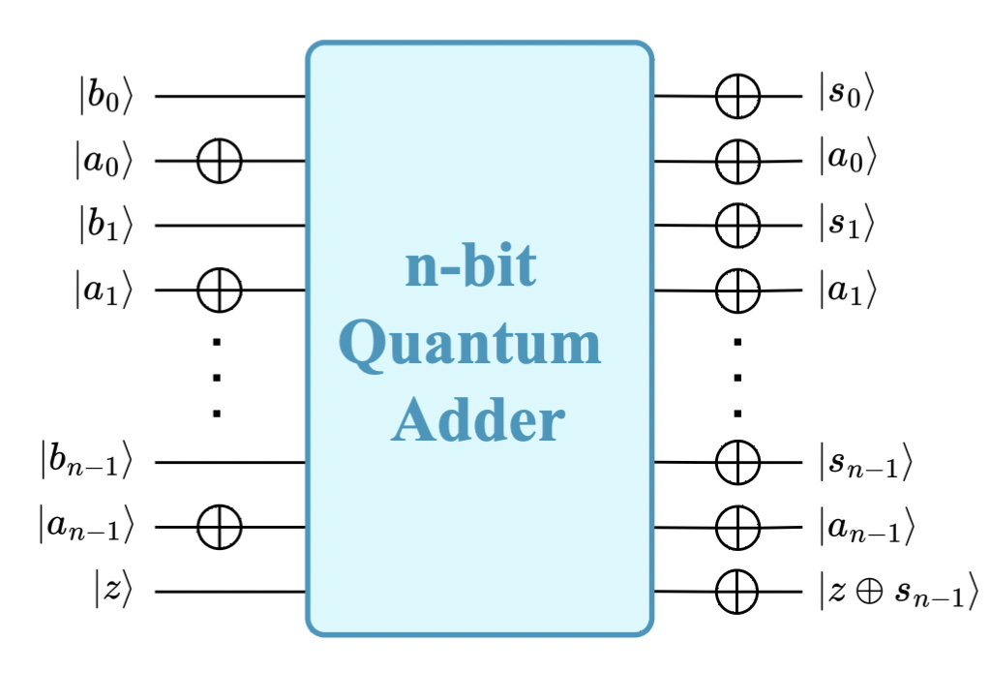
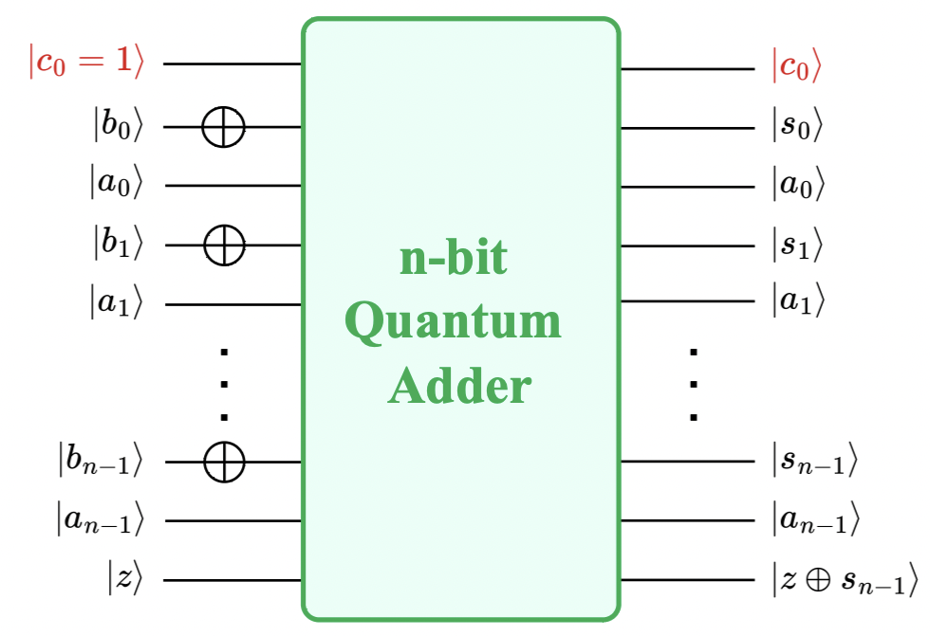
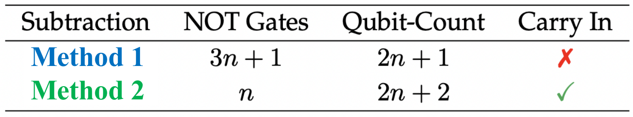
Subtraction
An n-bit quantum subtractor can be built with minor modifications to an n-bit quantum adder.
Method 1
Method 2
Cost Comparison

Slide 28



Division
Slow Division
Restoring
Non-Restoring
...
Fast Division
Newton–Raphson
Goldschmidt
...
Non-Standard Evaluation!
Slow Division
Restoring(2019, Thapliyal et al.[89])
Non-Restoring(2019, Thapliyal et al.[89])
...
Fast Division
Newton–Raphson(2022, Gayathri et al.[90])
Goldschmidt(2021, Gayathri et al.[69])
...
Division
Algorithm
Quantum
Division
Designs
Corrected!
Our Division Design
Comparison of 32-qubits Quantum Dividers
Fast division is slow in quantum???
Yes! Because Quantum IF is very expensive!

Slide 29



Multiplication
Basic Primitives
Compressor Primitives
Half Adder
Full Adder
Compare to existing Wallace Tree Quantum Multipliers:
Lower Toffoli-Count ↓
Lower Toffoli-Depth ↓
Comparable Qubit-Count
Schoolbook or shift-and-add methods often yield better Qubit-Count.

Slide 30




Modular Arithmetic (MOD)
Modular Addition
VBE Modular Addition Framework^{[25]}
Beckman Modular Addition Framework^{[26]}
Van Meter Modular Addition Framework^{[27]}
Rines-Chuang Modular Addition Framework^{[28]}
a+b-N

Slide 31


Why Use Carry-Save Architecture?
Our Design
High-Speed, Low-Cost with Low Latency
Minimizes delay by avoiding the need for immediate carry propagation.
Efficient Multi-Operand Addition
Reduces the time required for multi-operand additions.
Based on Addition Block

Slide 32

Performance of Our Design
Modular Addition Framework | Year | TD | TC | QC
VBE^{[25]} | 1996 | $$5×{TD}_{Add}$$ | $$5×{TC}_{Add}$$ | $$3n+2+{Anc}_{Add}$$
Beckman^{[26]} | 1996 | $$5×{TD}_{Add}$$ | $$6×{TC}_{Add}$$ | $$5n+1+{4×Anc}_{Add}$$
Van Meter^{[27]} | 2005 | $$3×{TD}_{Add}$$ | $$3×{TC}_{Add}$$ | $$3n+1+{Anc}_{Add}$$
Rines-Chuang^{[28]} | 2018 | $$3×{TD}_{Add}$$ | $$3×{TC}_{Add}$$ | $$3n+1+{2×Anc}_{Add}$$
Our Design | 2024 | $$2+2×{TD}_{Add}$$ | $$2n+2×{TC}_{Add}$$ | $$4n+1+{Anc}_{Add}$$
Theoretically, our design achieves the lowest TD
Lowest Toffoli Depth
60%
33.3%
Shor’s Acceleration
Improve TD (Time) of
Quantum Modular Framework
Improve TD (Time) of
Quantum Exponentiation

Slide 33



Overview
We had an overview paper for quantum arithmetic, which has been published by Philosophical Transactions of the Royal Society A.
Isaac Newton

Slide 34



04
Hardware Validation
How can we verify these designs?
NISQ device has 50–100 qubits, capable of limited quantum advantage despite error and noise constraints.
We are Here!
Quantity
Quality
Noisy intermediate-scale quantum(NISQ) computer

Slide 35





Validation Flow
Design
Programming
Verification
Quantum
Simulator
...
Quantum
Hardware

Slide 36


Industry Attention
Our Design!
Our designs have been incorporated into recent quantum algorithm APIs. It’s encouraging to see growing interest from the industry in our work.

Slide 37


MalaQ: The first Malware for Quantum Computers
The technological revolution ushered in by quantum computers has garnered widespread attention, rendering quantum machines the likely targets of cyber attacks.
Therefore,
we propose the 1st Malware Demo for Quantum Computer---MalaQ
Quantum Computer in NUS

Slide 38




Recognition & Impact
Quantum Computer Cybersecurity Symposium 2024
Our Work!
SWE@NTU Research Showcase 2025

Slide 39

05
Applications
Quantum
Machine Learning
Quantum
Arithmetic Circuits
Quantum
Cryptanalysis
QML
Q Crypt
......
......
Aimed at achieving a comprehensive exploration of the quantum domain from bottom to top.
Q Arithmetic

Slide 40





Application 1: Quantum Machine Learning
There are no quantum designs for implementing activation functions with a focus on fault tolerance so far.
Quantum Trick
Simultaneous execution of shared-control Toffoli
ReLU
Leaky ReLU
Performance
Our implementations achieve constant T-depth.

Slide 41



Application 2: Quantum Cryptanalysis
In symmetric-key cryptography, Grover's Attack^{[29]} poses the primary security threat.
LED-64
Quantum Oracles for Grover’s Attack
LED-128

Slide 42
06
Conclusion
Addition
Subtraction
Multiplication
Division
Modular Arithmetic
Overview
Verification
Malware Design
Q Machine Learning
Q Cryptanalysis
Quantum Arithmetic
Hardware Validation
Applications
In conclusion, my PhD research improved the efficiency of quantum arithmetic, thereby advancing various quantum applications and large-scale algorithms.

Slide 43



Research Question: How to improve the efficiency of Quantum Arithmetic?
Our Answer
Classical → Quantum
Classical techniques inspire quantum arithmetic designs
Quantum → Quantum Innovations in one quantum design inform others
Bridge classical and quantum computing
The connection between classical and quantum computing is indispensable.

Slide 44
List of Publications
Journal Papers
Wang, Siyi, Anubhab Baksi, and Anupam Chattopadhyay., (2023) "A Higher radix architecture for quantum carry-lookahead adder." Scientific Reports 13, no. 1: 16338.10.1038/s41598-023-41122-4
Wang, Siyi, Ankit Mondal, and Anupam Chattopadhyay., (2024) "Optimal Toffoli-Depth Quantum Adder." ACM Transactions on Quantum Computing,10.1145/3743691.
Wang, Siyi, Xiufan Li, Wei Jie Bryan Lee, Suman Deb, Eugene Lim, and Anupam Chattopadhyay., (2024) "A Comprehensive Study of Quantum Arithmetic Circuits." Philosophical Transactions of the Royal Society A, 10.1098/rsta.2023.0392
Zi, Wei, Siyi Wang, Hyunji Kim, Xiaoming Sun, Anupam Chattopadhyay, and Patrick Rebentrost., (2024) "Efficient quantum circuits for machine learning activation functions including constant T-depth ReLU." Physical Review Research 6, no. 4: 043048, 10.1103/PhysRevResearch.6.043048.
Book Chapter
Wang, Siyi, and Anupam Chattopadhyay.(2023) "Efficient Depth Optimization in Quantum Addition and Modular Arithmetic with Ling Structure." IFIP/IEEE International Conference on Very Large Scale Integration-System on a Chip. Cham: Springer Nature Switzerland, 2023.

Slide 45

List of Publications
Conference Proceedings
Wang, Siyi, and Anupam Chattopadhyay., (2023) "Reducing depth of quantum adder using ling structure." 2023 IFIP/IEEE 31st International Conference on Very Large Scale Integration (VLSI-SoC), 561–566. 10.1109/VLSI-SoC57769.2023.10321948
Wang, Siyi, Eugene Lim, and Anupam Chattopadhyay., (2024) "Boosting the Efficiency of Quantum Divider through Effective Design Space Exploration." 2024 IEEE International Symposium on Circuits and Systems (ISCAS), 10.1109/ISCAS58744.2024.10557991.
Wang, Siyi, Eugene Lim, Xiufan Li, Jerrie Feng, and Anupam Chattopadhyay., (2024) "Minimum Depth Quantum Modular Addition through Carry-Save Architecture", 2024 IFIP/IEEE 32st International Conference on Very Large Scale Integration (VLSI-SoC), 10.1109/VLSI-SoC62099.2024.10767796 (Best Paper Award)
Wang, Siyi, Alex Jin, Suman Deb, Tarun Dutta, Manas Mukherjee, and Anupam Chattopadhyay., (2024) "POSTER: MalaQ-A Malware Against Quantum Computer." In Proceedings of the 19th ACM Asia Conference on Computer and Communications Security, 10.1145/3634737.3659432. (Best Student Presentation Award)
Wang, Siyi, Kyungbae Jang, Anubhab Baksi, Sumanta Chakraborty, Bryan Lee, Anupam Chattopadhyay and Hwajeong Seo., (2024) "New Results in Quantum Analysis of LED: Featuring One and Two Oracle Attacks" IACR Communications in Cryptology, Under review.

Slide 46




Acknowledgment
Thesis Committee
Prof. Pun Chi Seng Prof. Wang Yong Prof. Tao Dacheng
Prof. Anupam Chattopadhyay

Slide 47











Acknowledgment
Family, Friends, and Coworkers...

Slide 48
Q&A Thank you for listening!

Slide 49
References
[1] Shor, P.W., 1999. Polynomial-time algorithms for prime factorization and discrete logarithms on a quantum computer. SIAM review, 41(2), pp.303-332.
[2] Gidney, Craig. Halving the cost of quantum addition. Quantum, 2:74, June 2018. ISSN 2521-327X. doi: 10.22331/q-2018-06-18-74. URL https://doi.org/10.22331/q-2018-06-18-74.
[3] T. Draper, S. Kutin, E. Rains, and K. Svore, “A logarithmic-depth quantum carry-lookahead adder,” Quantum Information and Computation, vol. 6, 07 2004.
[4] Y. Takahashi and N. Kunihiro, “A fast quantum circuit for addition with few qubits,” Quantum Information and Computation, vol. 8, pp. 636–649, 07 2008.
[5] Y. Takahashi, S. Tani, and N. Kunihiro, “Quantum addition circuits and unbounded fan-out,” Quantum Information and Computation, vol. 10, 10 2009.
[6] S. S. Gayathri, R. Kumar, S. Dhanalakshmi, G. Dooly, and D. B. Duraibabu, “T-count optimized quantum circuit designs for single-precision floating-point division,” Electronics, vol. 10, p. 703, 03 2021.
[7] S. S. Gayathri, R. Kumar, and S. Dhanalakshmi, “Efficient floating-point division quantum circuit using newton-raphson division,” Journal of Physics: Conference Series, vol. 2335, no. 1, p. 012058, sep 2022. [Online]. Available: https://dx.doi.org/10.1088/1742-6596/2335/1/012058
[8] C. Zalka, “Fast versions of shor’s quantum factoring algorithm,” arXiv preprint quant-ph/9806084, 1998.
[9] A. Parent, M. Roetteler, and M. Mosca, “Improved reversible and quantum circuits for karatsuba-based integer multiplication,” arXiv preprint arXiv:1706.03419, 2017.
[10] C.-C. Lin, A. Chakrabarti, and N. K. Jha, “Qlib: Quantum module library,” ACM Journal on Emerging Technologies in Computing Systems (JETC), vol. 11, no. 1, pp. 1–20, 2014.

Slide 50
References
[11] S. Kepley and R. Steinwandt, “Quantum circuits for f _ 2ˆ n f 2 n-multiplication with subquadratic gate count,” Quantum Information Processing, vol. 14, pp. 2373–2386, 2015.
[12] H. Jayashree, H. Thapliyal, H. R. Arabnia, and V. K. Agrawal, “Ancilla-input and garbage output optimized design of a reversible quantum integer multiplier,” The Journal of Supercomputing, vol. 72, pp. 1477–1493, 2016.
[13] S. Dutta, D. Bhattacharjee, and A. Chattopadhyay, “Quantum circuits for toom-cook multiplication,” Phys. Rev. A, vol. 98, p. 012311, Jul 2018.
[14] E. Muñoz-Coreas and H. Thapliyal, “Quantum circuit design of a t-count optimized integer multiplier,” IEEE Transactions on Computers, vol. 68, no. 5, pp. 729–739, 2018.
[15] C. Gidney, “Asymptotically efficient quantum karatsuba multiplication,” arXiv preprint arXiv:1904.07356, 2019.
[16] C. Gidney, “Windowed quantum arithmetic,” arXiv preprint arXiv:1905.07682, 2019.
[17] I. Van Hoof, “Space-efficient quantum multiplication of polynomials for binary finite fields with sub-quadratic toffoli gate count,” arXiv preprint arXiv:1910.02849, 2019.
[18] H. T. Larasati, A. M. Awaludin, J. Ji, and H. Kim, “Quantum circuit design of toom 3-way multiplication,” Applied Sciences, vol. 11, no. 9, p. 3752, 2021.
[19] S. Gayathri, R. Kumar, S. Dhanalakshmi, G. Dooly, and D. B. Duraibabu, “T-count optimized quantum circuit designs for single-precision floating-point division,” Electronics, vol. 10, no. 6, p. 703, 2021.
[20] S. Sajadimanesh, J. P. L. Faye, and E. Atoofian, “Practical approximate quantum multipliers for nisq devices,” in Proceedings of the 19th ACM International Conference on Computing Frontiers, pp. 121–130, 2022.
[21] D. S. C. Putranto, R. W. Wardhani, H. T. Larasati, and H. Kim, “Space and time-efficient quantum multiplier in post quantum cryptography era,” IEEE Access, vol. 11, pp. 21848–21862, 2023.

Slide 51
References
[22] F. Orts, E. Filatovas, G. Ortega, J. SanJuan-Estrada, and E. Garzón, “Improving the number of t gates and their spread in integer multipliers on quantum computing,” Physical Review A, vol. 107, no. 4, p. 042621, 2023.
[23] J. Nie, Q. Zhu, M. Li, and X. Sun, “Quantum circuit design for integer multiplication based on schönhage-strassen algorithm,” IEEE Transactions on Computer-Aided Design of Integrated Circuits and Systems, 2023.
[24] K. Jang, W. Kim, S. Lim, Y. Kang, Y. Yang, and H. Seo, “Quantum binary field multiplication with optimized toffoli depth and extension to quantum inversion,” Sensors, vol. 23, no. 6, p. 3156, 2023.
[25] Vedral, V., Barenco, A. and Ekert, A., 1996. Quantum networks for elementary arithmetic operations. Physical Review A, 54(1), p.147.
[26] Beckman, D., Chari, A.N., Devabhaktuni, S. and Preskill, J., 1996. Efficient networks for quantum factoring. Physical Review A, 54(2), p.1034.
[27] Van Meter, R. and Itoh, K.M., 2005. Fast quantum modular exponentiation. Physical Review A—Atomic, Molecular, and Optical Physics, 71(5), p.052320.
[28] Rines, R. and Chuang, I., 2018. High performance quantum modular multipliers. arXiv preprint arXiv:1801.01081.
[29] Grover, Lov K. A fast quantum mechanical algorithm for database search. In Proceedings of the twenty-eighth annual ACM symposium on Theory of computing, pages 212–219, 1996.

Slide 52

07
Appendix
Quantum Higher Radix Adder

Slide 53





Quantum Ling Adder
Step 1
Step 2: Pre-calculation

Slide 54
Modular Addition
CSA Module
Uncompute S Module
Set 0 Module
Add Module
Sub Module

Slide 55




Method
Main Modules
Add Module
Sub Module
represents a quantum adder.
There are various quantum adders.
denotes a quantum subtractor,
which is a direct application of Add.
$$a−b={(a^{’}+b)}^{’}$$
CSA Module
Uncompute S Module
Set 0 Module
represents the carry-save architecture, consisting of a series of full adders operating in parallel.
uncompute the partial sum S,
which can be achieved through CNOTs.
can be implemented using CNOTs.

Slide 56


Method
Add/Sub Module
Add/Sub | TD | TC | QC
Gayathri[6] | $$n$$ | $$n$$ | $$3n+1$$
Takahashi[7] | $$2n−1$$ | $$2n−1$$ | $$2n+1$$
Optimal TD[8] | $$\log{n}+1$$ | $$\frac{n\log{n}}{2}$$ | $$n+n\log{n}$$ $$+\left\lceil \log{n}\right\rceil +2$$

Slide 57

Results
Experiment 1
Our Design_Takahashi
Takahashi: low QC Adder
Our Design_Gayathri
Gayathri: low TC Adder
Our Design_OptimalTD
OptimalTD: low TD Adder
33.3%
TD Comparison
TD(Time)
Improvement

Slide 58


Results
Experiment 1
TC
Rines-Chuang framework with Gayathri Add achieves the lowest TC cost, with our design closely following as the second lowest.
QC
Our design exhibits a QC that falls slightly below the Beckman framework.
Discussions
The choice of Add Block and Modular Framework significantly impacts the performance of modular adders.
Our designs exhibit up to 33.3% reduction in TD, while keeping TC and QC at comparable levels.
TC Comparison
QC Comparison

Slide 59


Results
Experiment 2: Influence on Quantum Modular Exponentiation
VBE Modular Multiplication Framework^{[2]}
SETState
Modular Adder
$${TD}_{C−MODMul}=2n×SETState +n×{TD}_{MODAdd}$$
${TC}_{C−MODMul}=$ $2n×SETState +n×{TC}_{MODAdd}$ $${QC}_{C−MODMul}=1+n+{QC}_{MODAdd}$$

Slide 60




Results
Experiment 2
VBE Modular Exponentiation Framework^{[2]}
n-bit controlled modular multiplier
$$a^{x}mod N$$
$(x$ is an n-bit binary number)
60%
$${TD}_{MODExp}=2n×{TD}_{C−MODMul}=4n^{2}×SETState +2n^{2}×{TD}_{MODAdd}$$
${TC}_{MODExp}=$ $2n×{TC}_{C−MODMul}=4n^{2}×SETState +2n^{2}×{TC}_{MODAdd}$ $${QC}_{MODExp}=n+{QC}_{C−MODMul}=1+2n+{QC}_{MODAdd}$$
TD(Time)
Improvement

Slide 61

Quantum Division
Comprehensive application of DSE methodology during quantum divider design

Slide 62



Slide 63

Results and Discussions

Slide 64



Results and Discussions

Slide 65


Quantum Multiplication
Basic Primitives (HA, FA)
Our Primitives (Compressors)
Example
10-4 compressor adder using 5-3 compressor adders
Half Adder (HA)
Full Adder (FA)
Existing designs of quantum multiplier^{[2,3,4]} often rely on basic half and full-adders as primitives.
In contrast, classical arithmetic circuit designs leverage the compressor primitive, having demonstrated superior performance^{[5,6,7]}.

Slide 66


Methodology: Compressor-based Wallace Tree Multiplier
B₉ Quantum Compressor
8x8 Wallace Tree multiplication based on B𝐵₇

Slide 67

Experiment: Determining the Optimal Compression Size
We investigate the optimal compression size l using 3 strategies:
Strategy 1: Use the largest possible compressor size.
Strategy 2: Use the largest compressor with maximum compression ratio.
Strategy 3: Brute-force search.
T-Depth Optimization
Using OptimalTD-Add, Strategy 3 performs best but scales poorly.
For larger N, Strategy 1 outperforms Strategy 2 in minimizing T-Depth.
T-Depth Comparision

Slide 68


Experiment: Determining the Optimal Compression Size
T-Count Optimization
We adopt OptimalTC-Add as the CPA.
While Strategy 3 (brute-force) yields the lowest T-Count, it is impractical for large N.
In such cases, Strategy 1 (largest compressors) is a practical and efficient alternative.
Qubit-Count Minimization
Naive or shift-and-add methods often yield better Qubit-Count.
Within our framework, Strategy 1 matches or outperforms Strategy 2, while Strategy 3 remains optimal but costly.
Note
Brute-force optimization is ideal for small-scale multiplications.
For larger circuits, Strategy 1 offers the best balance of performance and scalability.
T-Count Comparision
Qubit-Count Comparision

Slide 69


MalaQ
To date, no documented attack has successfully achieved direct control over a quantum computer.
we successfully overcame these challenges, culminating in the development of the first malware targeting quantum computers.
Challenge 1: The complex and unique nature of quantum systems.
Challenge 2: Gap between quantum and cybersecurity

Slide 70



Methodology: Detailed Step-by-step Breakdown of the Attack
Step1: Design and program a reverse TCP-based malware
Step 3: Execution MalaQ on the Target CPU
Step 2: Delivery MalaQ to the Target CPU
Attacked！
Step 4: Access to the Target System.
Step 6: Run the erronerous quantum application.
Step 5: Attack on Quantum Classifier.

Slide 71


Results: Quantum Simulator
Lowest Accuracy

Slide 72


Results: Quantum Hardware
Here, we utilized a real Noisy Intermediate-Scale Quantum (NISQ) device.
Very Expensive......
This attack significantly reduces classifier accuracy, undermining the reliability of real quantum hardware.

Slide 73


Why MalaQ?
In this paper, we introduced MalaQ^{[1]}, a novel malware targeting vulnerabilities in quantum-classical hybrid computing systems.
Mala
Quantum
MALAQ
MALware Attacks Quantum
+
=

Slide 74



Application 1: Q Machine Learning
Recently, numerous research findings on QNNs based
on quantum circuit implementations have been proposed
[15–19]. It turns out that the implementation of activation
functions, using quantum circuits, is fundamental and crucial
in QNNs. However, to the best of the authors’ knowledge, there are no dedicated circuit designs for implementing activation functions with a focus on fault tolerance so far.
Quantum Neural Networks (QNNs) represent an intersection between quantum computing and artificial neural networks, hot topic.
Activation Function
Quantum Neural Networks (QNNs)
In this work, we address this gap by constructing a quantum circuit using Clifford+T gates.

Slide 75





Activation Function: Leaky Relu
T-depth=(n-1)*2*3
Simplify it to shifting
x=0 x=1
{0.125,0.0625,0.03125,0.015625}
{2^-3, 2^-4, 2^-5, 2^-6}

Slide 76

Quantum Trick
Constant T-Depth=4+4=8
The T gate is also known as the pi/4 gate working on a single qubit. Hence, maximum 4
Activation functions are integral components in ml&dl,
providing the crucial non-linearity required for effective learning.

Slide 77







Application 2: Quantum Cryptography

Slide 78



Matrix Problem
SubCells
LIGHTER-R only deals at the top level (i.e., Toffoli gates), whereas DORCIS takes quantum decomposition (i.e., Clifford + T gates) into account.

Slide 79




MixColumn

Slide 80



